Slide 1
Intro to .NET Core SDK
Spencer Schneidenbach
@schneidenbach
spencer@avironsoftware.com
Notes:
Slide deck originally by Jon Galloway

Slide 2
.NET Core Goals
Cross-platform
Open source
Any Tooling

Slide 3
What it is NOT

Slide 4
.NET Standard vs .NET Core

Slide 5
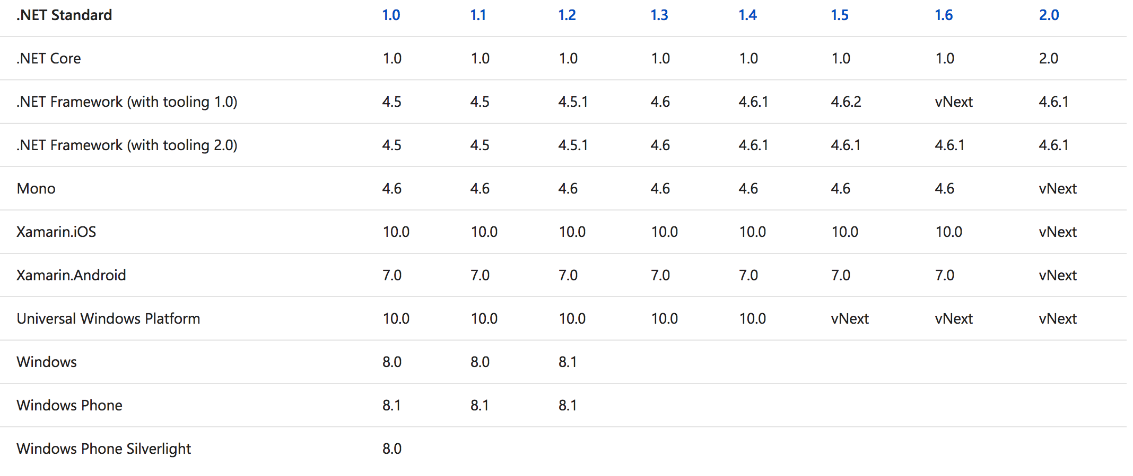
Helpful chart

Slide 6
Helpful rule
The higher the version, the more APIs are available to you.
The lower the version, the more platforms you can run on. (from the official FAQ)

Slide 7
Demos

